Slide 1
DATA STRUCTURES AND ALGORITHMS
Dr. e. Sophiya
Assistant professor
Dept of csse
Sree vidyanikethan engineering college

Slide 2
UNIT I– Introduction, Sorting and Searching
Introduction: Introduction to data structures, Introduction to Algorithm, Performance Analysis- Space Complexity, Time Complexity, Asymptotic Notation- Big Oh, Omega, Theta notations, Guidelines for Asymptotic Analysis, Algorithms Analysis: Problems & Solutions.
Sorting: Bubble Sort, Insertion sort, Selection Sort, Shell Sort, Radix sort and their performance analysis.
Searching: Linear Search, Binary Search and their performance analysis.

Slide 3
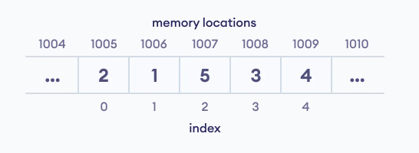
Overview of Data Structures
Data structure is a storage that is used to store and organize data.
It is a way of arranging data on a computer so that it can be accessed and updated efficiently.
Depending on your requirement and project, it is important to choose the right data structure for your project.
For example, if you want to store data sequentially in the memory, then you can go for the Array data structure.

Slide 4
Basically it deals with the manipulation and organization of data.
The major advantages of data structures are listed below:
It provides different levels of organizing data.
Management of large dataset
Design of efficient algorithms
Types of Data Structure
Basically, data structures are divided into two categories:
Linear data structure
Non-linear data structure

Slide 5
1. Linear data structures
In linear data structures, the elements are arranged in sequence one after the other.
Since elements are arranged in particular order, they are easy to implement.
However, when the complexity of the program increases, the linear data structures might not be the best choice because of operational complexities.
Popular linear data structures are:
Array Data Structure
Stack Data Structure
Queue Data Structure
Linked List Data Structure

Slide 6
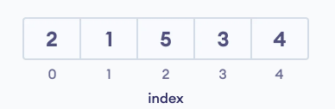
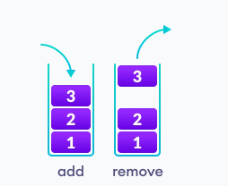
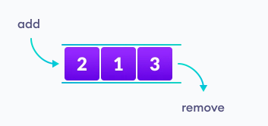
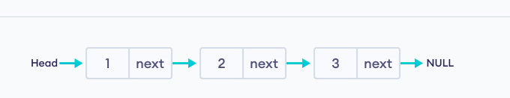
Array
Stack
queue
Linked list

Slide 7
2. Non linear data structures
Unlike linear data structures, elements in non-linear data structures are not in any sequence.
Instead they are arranged in a hierarchical manner where one element will be connected to one or more elements.
Non-linear data structures are further divided into:
Graph
Tree based data structures
Tables
Sets

Slide 8
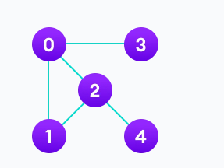
In graph data structure, each node is called vertex and each vertex is connected to other vertices through edges.
Popular Graph Based Data Structures:
Spanning Tree and Minimum Spanning Tree
Strongly Connected Components
Adjacency Matrix
Adjacency List

Slide 9
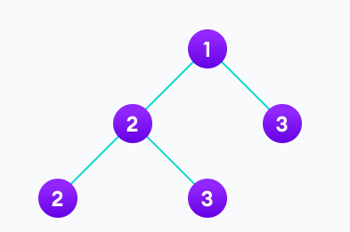
A tree is also a collection of vertices and edges.
However, in tree data structure, there can only be one edge between two vertices.
Popular Tree based Data Structure
Binary Tree
Binary Search Tree
AVL Tree
B-Tree
B+ Tree
Red-Black Tree

Slide 10

Hash Table
Hashing is a technique that is used to uniquely identify a specific object from a group of similar objects.
The Hash table data structure stores elements in key-value pairs where
Key- unique integer that is used for indexing the values
Value - data that are associated with keys.
The idea of hashing is to distribute entries (key/value pairs) uniformly across an array.
Each element is assigned a key (converted key).
By using that key you can access the element.

Slide 11
A set is a data structure that can store any number of unique values in any order you so wish.

Slide 12
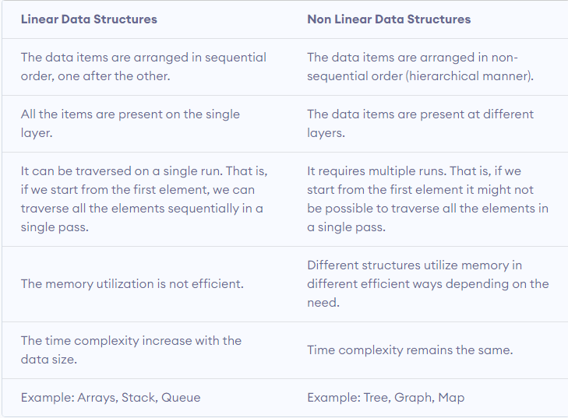

Slide 13
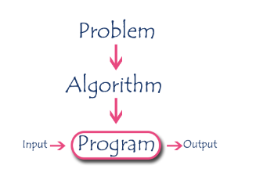
Introduction to Algorithm
Algorithm is a step-by-step procedure, which defines a set of instructions to be executed in a certain order to get the desired output.

Slide 14
Algorithm has the following characteristics
• Input: An algorithm may or may not require input
• Output: Each algorithm is expected to produce at least one result
• Definiteness: Each instruction must be clear and unambiguous.
• Finiteness: If the instructions of an algorithm are executed, the algorithm
should terminate after finite number of steps

Slide 15
Performance Analysis
There are multiple algorithms to solve a problem. When we have more than one algorithm to solve a problem, we need to select the best one.
Performance analysis helps us to select the best algorithm from multiple algorithms to solve a problem.
Performance of an algorithm means predicting the resources which are required to an algorithm to perform its task.
use a set of parameters or set of elements like memory required by that algorithm, the execution speed of that algorithm, easy to understand, easy to implement, etc.,

Slide 16
When we want to analyse an algorithm, we consider only the space and time required by that particular algorithm and we ignore all the remaining elements.
Performance analysis of an algorithm can also be defined as:
Performance analysis of an algorithm is the process of calculating space and time required by that algorithm.

Slide 17
Time complexity
Amount of time required for an algorithm for its execution.
Best case Time Complexity – Minimum amount of Time
Worst case Time Complexity – Maximum amount of Time
Average case Time Complexity – Average amount of Time
Approaches:
1. Frequency count or step count
2. Asymptotic notations

Slide 18
On what basis we could compare the time complexity of the data structures?
Based on operations performed by them.
Example:
Inserting an element at the beginning of the list is faster in Linked list than Array.

Slide 19
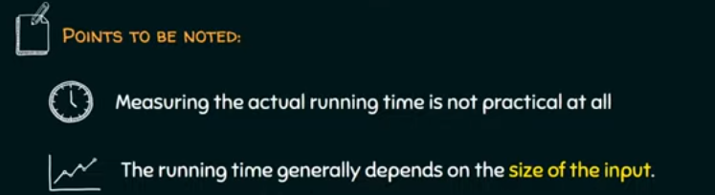
Asymptotic notations

Slide 20
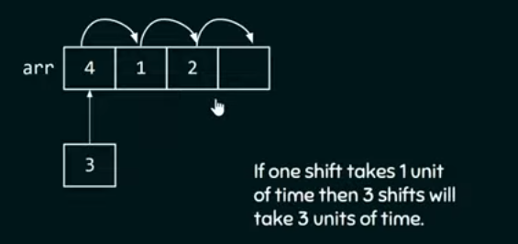
Inserting an element at the beginning of Array.

Slide 21

If we have 1000 elements in an array?
Therefore, if the size of input is n, then f(n) is a function of n denotes time complexity.
f(n)=n

Slide 22
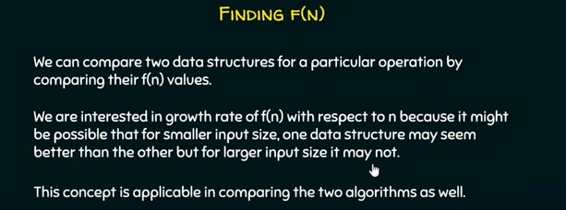

Slide 23
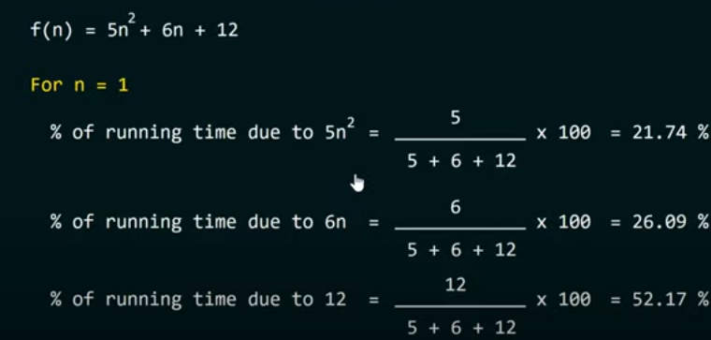

Slide 24
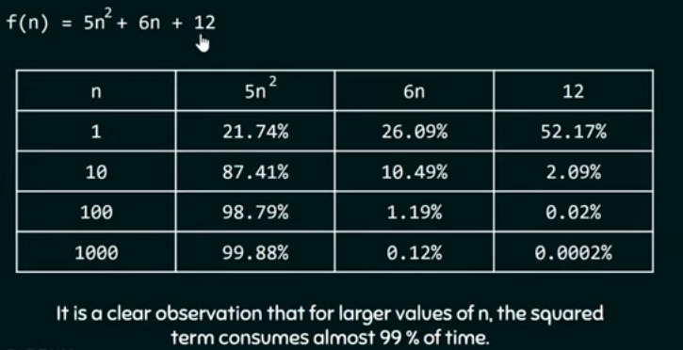

Slide 25
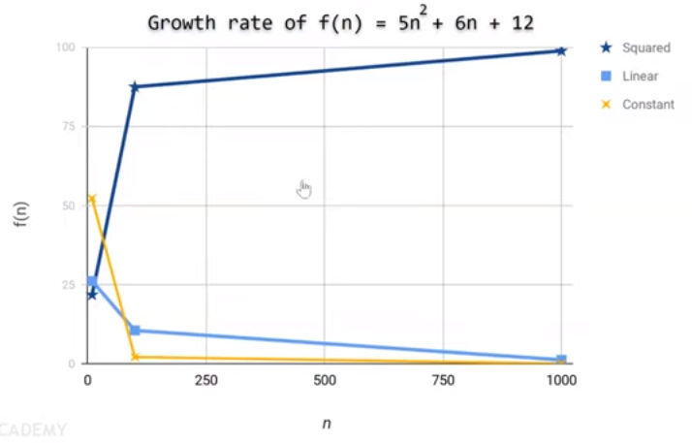

Slide 26
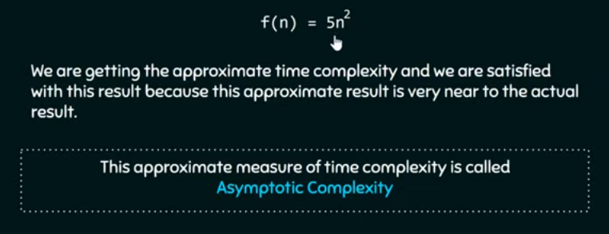

Slide 27
Asymptotic Notations
Following are the commonly used asymptotic notations to calculate the running time complexity of an algorithm.
Ο Notation (Big Oh Notation)
Ω Notation (Omega Notation)
θ Notation (Theta Notation)

Slide 28
Big - Oh Notation (O)
This notation describes the upper bound of the running time for an algorithm.
Big Oh notation ensures that the function never grows faster than its upper bound.
Thus, it measures the performance of an algorithm by describing the order of growth for a function and by giving the least upper bound for that function.
Big Oh measures the worst-case time complexity for the given algorithm i.e., it measures the longest time an algorithm can execute.

Slide 29
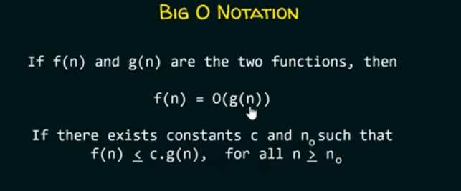
We are providing an upper bound to f(n)
i.e. For any value of n, the running time of an algorithm does not cross the time provided by O(g(n)).

Slide 30
Let f(n) = 3n+2 and g(n) = n.
We need to check whether f(n) = O(g(n)) or not.
For f(n) to be equal to O(g(n)), both the functions f(n) and g(n) must satisfy the following condition: f(n) ≤ c.g(n).
To check if the condition holds, replace f(n) by 3n+2 and g(n) by n
i.e. 3n+2 <= c.n
Let c=7 and n=1, then 3(1)+2 <= 7*1 ⇒ 5<=7 which is true.
Thus, f(n) <= c.g(n) is true for n=1.
For n=2, 3(2)+2 <= 7*2 ⇒ 8 <= 14 which is again true.
Therefore, f(n) <=c.g(n) is true for n=2 as well.

Slide 31
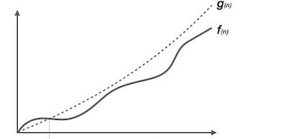
From here, we can conclude that f(n) <= c.g(n) holds for all values of n, given that c=7.
Thus, we can say that the above equation always holds for some constant c and some constant n0.
So, f(n) is equal to Big Oh of g(n) i.e. f(n) = O(g(n)) or we can say that c.g(n) is an upper bound on function f(n).

Slide 32
Big - Omega Notation (Ω)
It is the opposite of Big-Oh notation.
Omega notation always describes the best-case scenario for a particular algorithm.
Omega represents the lower bound of running time for an algorithm.
It will measure the least amount of time that an algorithm can take for its execution in the best case.
Computing omega:
1. Let f(n) and g(n) be two functions defined on a set of natural numbers.
2. Then, f(n) = Ω(g(n)) only if the growth of f(n) is faster than the growth of g(n).
3. Mathematically, its equation will be f(n) ≥ c.g(n) where c and n0 are constants such that c>0 and n>n0.

Slide 33
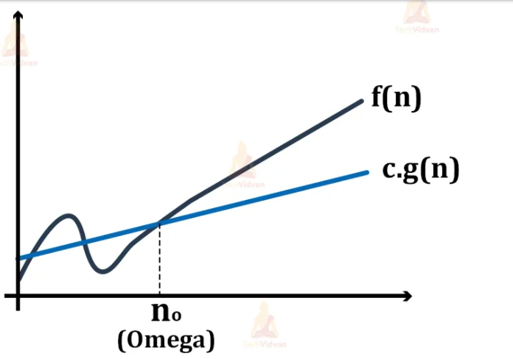
1. Let f(n) = 2n+3, g(n) = n, we need to find whether f(n)= Ω (g(n)) or not.
2. For f(n) to be equal to the omega of g(n), it must satisfy the condition:
f(n)≥ c.g(n)
3. Replace f(n) by 2n+3 and g(n) by n. i.e. 2n+3 ≥ c*n
4. Let c=1 i.e. value of constant c=1.
5. For n=1, 2(1) + 3 ≥ 1(1) .⇒ 5 ≥ 1 which is true.
6. Similarly, for n=2, 2(2)+3 ≥ 1(2) ⇒ 7 ≥ 2 which is again true.
7. If we check for further values, the equation holds for every value of n given that c=1.
The function g(n) is the lower bound of the function f(n) and thus it gives the running time for the function f(n) in the best possible case.

Slide 34
Big - Theta Notation (Θ)
While Big Oh gives the worst-case analysis and omega gives the best case analysis, theta lies somewhere in between.
Theta notation gives the average case analysis for a function or algorithm.
In real-world problems, not every time the algorithm will have either the best or worst-case scenario.
Practically, an algorithm is always performing in some average case i.e. the algorithm keeps on fluctuating.
Computing Theta
1. Let there be two functions: f(n) and g(n) defined on a set of positive integers.
2. Then, f(n) = Θ(g(n)) if c1.g(n)≤ f(n)≤ c2.g(n) where c1, c2 are constants.
3. In theta notation, two limits bind the function i.e. both the upper limit as well as the lower limit. This is what makes the theta notation return the average case for an algorithm.
4. Thus, the condition f(n)= θg(n) becomes true only when c1.g(n) is less than or equal to f(n) and c2.g(n) is greater than or equal to f(n).

Slide 35
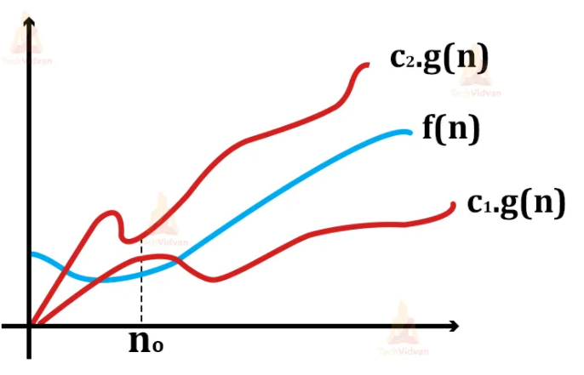
1. Let f(n) = 2n+3 and g(n) = n.
2. Replace f(n) with 2n+3 and g(n) with n in the equation
c1.g(n)≤ f(n)≤ c2.g(n).
Then the equation will be c1.n ≤2n+3≤ c2.n
3. To ensure that the equation holds, let c1=1 and c2=5.
4. Thus, for n=1,
the equation will be 1(1) ≤ 2(1)+3 ≤ 5(1) ⇒ 1 ≤ 5 ≤ 5 which is true.
5. For n=2,
The equation will be 1(2) ≤ 2(2)+3 ≤ 5(2) ⇒ 2 ≤ 7 ≤ 10 which is again true.
6. Hence, we can say that the equation holds for all the values of n given that c1=1 and c2=5.
7. Therefore, we can say that for the above example, f(n) is equal to θ(g(n)). And it gives average-case complexity for f(n).

Slide 36
Common asymptotic notations
Constant O(1)
Logarithmic O(log n)
Linear O(n)
n log n O(n log n)
Quadratic O(n2)
Cubic O(n3)
Polynomial nO(1)
Exponential 2O(n)

Slide 37
Time complexity of some most commonly used algorithms
Searching techniques:
Algorithm | Worst-case complexity
Linear search | O(n)
Binary search | O(log n)
Sorting techniques:
Algorithm Worst-case complexity
Insertion sort O(n2)
Selection sort O(n2)
Bubble sort O(n2)
Merge sort O(n logn)
Quicksort O(n2)
Radix sort O(nk)
Bucket sort O(n2)

Slide 38
Space complexity
Amount of space required for an algorithm for its execution.
For any algorithm, memory is required for the following purposes...
To store program instructions.
To store constant values.
To store variable values.
And for few other things like function calls, jumping statements etc,.

Slide 39
when a program is under execution it uses the computer memory for THREE reasons.
Instruction Space: It is the amount of memory used to store compiled version of instructions.
Environmental Stack: It is the amount of memory used to store information of partially executed functions at the time of function call.
Data Space: It is the amount of memory used to store all the variables and constants.

Slide 40
To calculate the space complexity, we must know the memory required to store different datatype values (according to the compiler).
2 or 4 bytes to store Integer value.
4 bytes to store Floating Point value.
1 byte to store Character value.
6 (OR) 8 bytes to store double value.
If any algorithm requires a fixed amount of space for all input values then that space complexity is said to be Constant Space Complexity.
int square(int a)
{
return a*a;
}
How many bytes of memory required to store variable ’a’ ?

Slide 41
int sum(int A[ ], int n)
{
int sum = 0, i;
for(i = 0; i < n; i++)
sum = sum + A[i];
return sum;
}
If the amount of space required by an algorithm is increased with the increase of input value, then that space complexity is said to be Linear Space Complexity.

Slide 42
Sorting
Arranging elements of an array in a particular order is called sorting.
The order of arrangement may be ascending or descending in nature.
There are several methods of arranging or sorting arrays.
Some of the sorting methods include:
Bubble sort
Selection sort
Insertion sort
Merge sort
Quick sort
Shell Sort
Radix sort

Slide 43
Bubble sort
Bubble sort is a sorting algorithm that compares two adjacent elements and swaps them until they are not in the intended order.
Suppose we are trying to sort the elements in ascending order.
1.First Iteration (Compare and Swap)
Starting from the first index, compare the first and the second elements.
If the first element is greater than the second element, they are swapped.
Now, compare the second and the third elements. Swap them if they are not in order.
The above process goes on until the last element

Slide 44
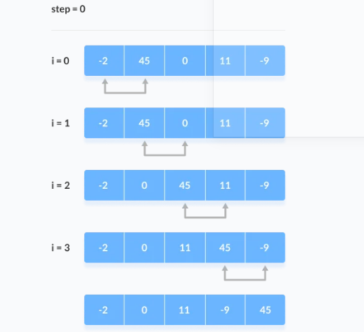

Slide 45
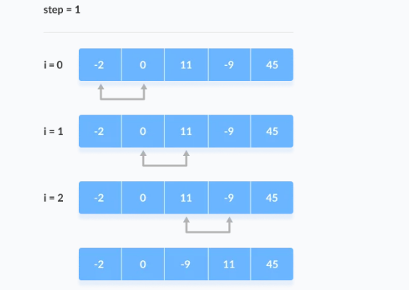
2. Remaining Iteration
The same process goes on for the remaining iterations.
After each iteration, the largest element among the unsorted elements is placed at the end.

Slide 46
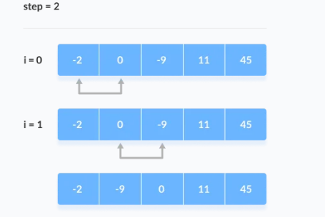
In each iteration, the comparison takes place up to the last unsorted element.

Slide 47
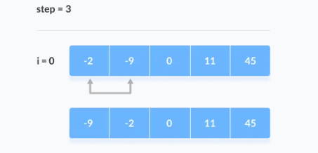
The array is sorted when all the unsorted elements are placed at their correct positions.

Slide 48
#include<stdio.h>
int main()
{
int a[10],i,j,temp,n;
printf("\n Enter the max no.of Elements to Sort: \n");
scanf("%d",&n);
printf("\n Enter the Elements : \n");
for(i=0; i<n; i++)
{
scanf("%d",&a[i]);
}
for(i=0; i<n; i++)
for(j=i+1; j<n; j++)
{
if(a[i]>a[j])
{
temp=a[i];
a[i]=a[j];
a[j]=temp;
}
}
for(i=0; i<n; i++)
{
printf(“elements after sort:%d\t",a[i]);
}
return 0;
}
Enter the max no.of Elements to Sort: 5
Enter the Elements :
-2
45
0
11
-9
elements after sort: -9 -2 0 11 45

Slide 49
Time Complexity
Best Case Complexity - It occurs when there is no sorting required, i.e. the array is already sorted.
Average Case Complexity - It occurs when the array elements are in jumbled order that is not properly ascending and not properly descending.
Worst Case Complexity - It occurs when the array elements are required to be sorted in reverse order. That means suppose you have to sort the array elements in ascending order, but its elements are in descending order.
Case | Time Complexity
Best Case | O(n)
Average Case | O(n²)
Worst Case | O(n²)

Slide 50

Selection Sort
Selection sort is a sorting algorithm that selects the smallest element from an unsorted list in each iteration.
And places that element at the beginning of the unsorted list.
Set first element in list as minimum.
Compare second element with minimum.
If the second element is smaller than minimum, assign the second element as minimum.
Compare 3rd element with minimum.
If the 3rd element is smaller than minimum, assign the 3rd element as minimum.
And it continues until last element

Slide 51
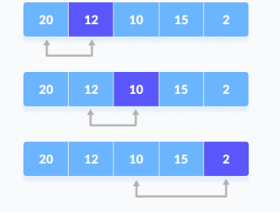
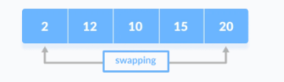
3.After each iteration place minimum at front of unsorted list.

Slide 52
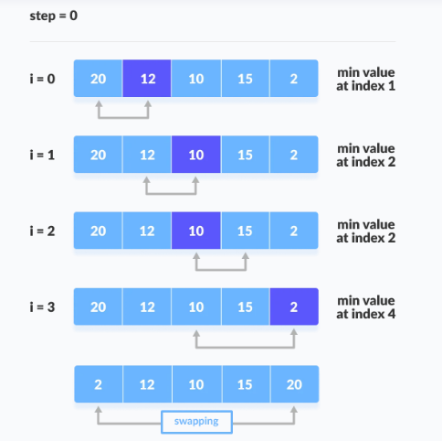
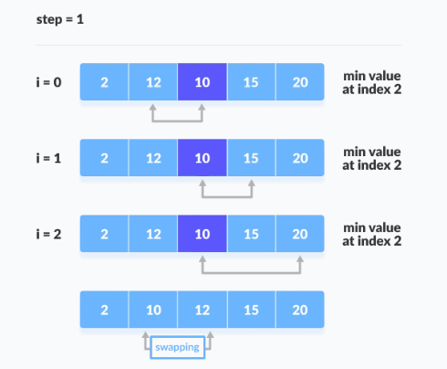
4.For each iteration, indexing starts from the first unsorted element.
Step 1 to 3 are repeated until all the elements are placed at their correct positions.

Slide 53
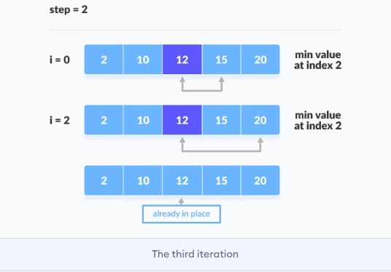
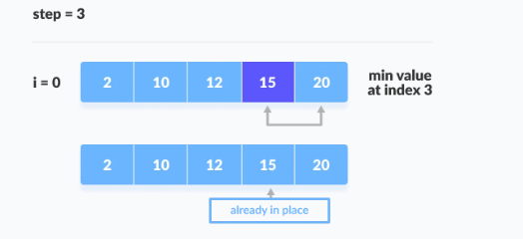

Slide 54
#include <stdio.h>
int main()
{
int array[5], n, i, j, min, t;
printf("Enter number of elements\n");
scanf("%d", &n);
printf("Enter %d integers\n", n);
for (i = 0; i < n; i++)
scanf("%d", &array[i]);
for (i = 0; i < (n - 1); i++) // finding minimum element (n-1)times
{
min = i;
for (j = i + 1; j < n; j++)
{
if (array[min] > array[j])
min = j;
}
if (min != i)
{
t = array[i];
array[i] = array[min];
array[min] = t;
}
}
printf("Sorted list in ascending order:\n");
for (i = 0; i < n; i++)
printf("%d\n", array[i]);
return 0;
}
Enter number of elements
5
Enter 5 integers
20
13
5
18
55
Sorted list in ascending order:
5
13
18
20
55

Slide 55
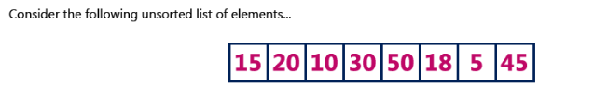

Slide 56
Insertion Sort
Sorting is the process of arranging a list of elements in a particular order (Ascending or Descending).
Insertion sort algorithm arranges a list of elements in a particular order.
In insertion sort algorithm, every iteration moves an element from unsorted portion to sorted portion until all the elements are sorted in the list.
Procedure:
Step 1 - Assume that first element in the list is in sorted portion and all the remaining elements are in unsorted portion.
Step 2: Take first element from the unsorted portion and insert that element into the sorted portion in the order specified.
Step 3: Repeat the above process until all the elements from the unsorted portion are moved into the sorted portion.

Slide 57
Consider the following list of elements: 15 20 10 30 50 18 5 45
Solution:
1. Assume first element 15 is in sorted position.
2. To place element 20 to sorted position, compare 20 with its previous element 15.
If the second element is smaller than previous, insert second element at its correct position.
15 20 10 30 50 18 5 45
15 20 10 30 50 18 5 45
15 20 10 30 50 18 5 45

Slide 58
3. To move next element 10 to its sorted position, compare 10 with 20 and again with 15. if it is smaller, insert 10 at its sorted position.
15 20 10 30 50 18 5 45
15 10 20 30 50 18 5 45
10 15 20 30 50 18 5 45

Slide 59
4. To move 30 from unsorted to sorted position, compare 30 with 20,15,10.
10 15 20 30 50 18 5 45
since 30 is larger than all sorted elements, 30 is inserted directly on its sorted portion.
10 15 20 30 50 18 5 45

Slide 60
5. To move 50 from unsorted to sorted position, compare 50 with 30,20,15,10.
10 15 20 30 50 18 5 45
since 50 is larger than all sorted elements, 50 is inserted directly on its sorted portion.
10 15 20 30 50 18 5 45

Slide 61
6. To move element 18 to its sorted position, compare 18 with 50, 30, 20, 15,10.
since 18 is larger than 15, move 20, 30 and 50 one position to right in list and insert 18 on its sorted position after 15.
10 15 20 30 50 18 5 45
10 15 18 20 30 50 5 45

Slide 62
7. Repeat the same process for rest of the elements in unsorted list until all elements are inserted in their sorted position.
5 10 15 18 20 30 45 50

Slide 63
#include<stdio.h>
void main()
{
int size, i, j, temp, list[5];
printf("Enter the size of the list: ");
scanf("%d", &size);
printf("Enter %d integer values: ", size);
for(i = 0; i < size; i++)
scanf("%d", &list[i]);
//Insertion sort logic
for (i = 1; i < size; i++)
{
temp = list[i];
for(j=i;j>0 && temp<list[j-1];j--)
{
list[j]=list[j-1];
}
list[j]=temp;
}
printf("List after Sorting is: ");
for (i = 0; i < size; i++)
printf(" %d", list[i]);
}

Slide 64
Radix Sort
Radix sort is one of the sorting algorithms used to sort a list of integer numbers in order.
In radix sort algorithm, a list of integer numbers will be sorted based on the digits of individual numbers.
Sorting is performed from least significant digit to the most significant digit.
Radix sort algorithm requires the number of passes which are equal to the number of digits present in the largest number among the list of numbers.
For example, if the largest number is a 3 digit number(131) then that list is sorted with 3 passes.

Slide 65
Step 1 - Define 10 queues each representing a bucket for each digit from 0 to 9.
Step 2 - Consider the least significant digit of each number in the list which is to be sorted.
Step 3 - Insert each number into their respective queue based on the least significant digit.
Step 4 - Group all the numbers from queue 0 to queue 9 in the order they have inserted into their respective queues.
Step 5 - Repeat from step 3 based on the next least significant digit.

Slide 66
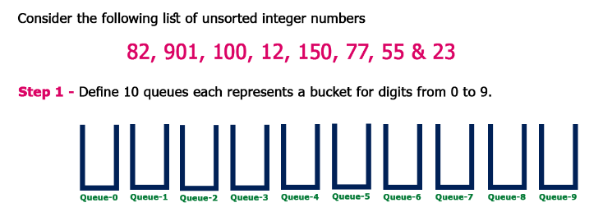

Slide 67
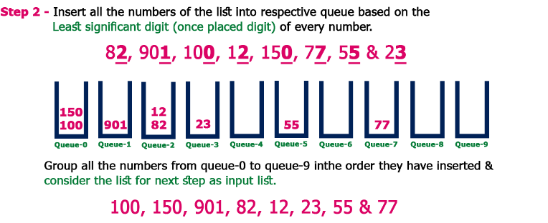

Slide 68
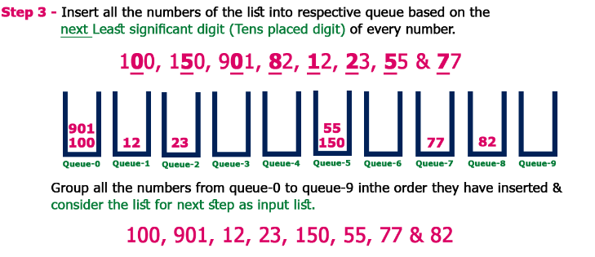

Slide 69
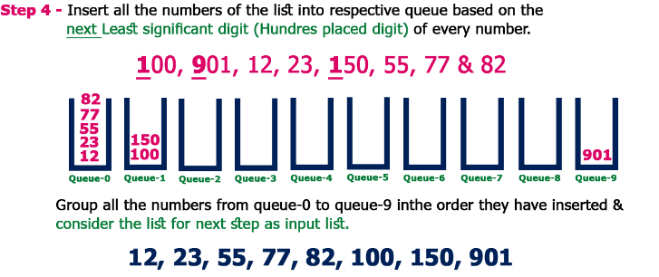

Slide 70
Complexity of the Radix Sort Algorithm
To sort an unsorted list with 'n' number of elements, Radix sort algorithm needs the following complexities...
Worst Case : O(n)
Best Case : O(n)
Average Case : O(n)

Slide 71
Linear Search Algorithm
Search is a process of finding a value in a list of values.
Step 1 - Read the search element from the user.
Step 2 - Compare the search element with the first element in the list.
Step 3 - If both are matched, then display "Given element is found!!!" and terminate the function
Step 4 - If both are not matched, then compare search element with the next element in the list.
Step 5 - Repeat steps 3 and 4 until search element is compared with last element in the list.
Step 6 - If last element in the list also doesn't match, then display "Element is not found!!!" and terminate the function.

Slide 72

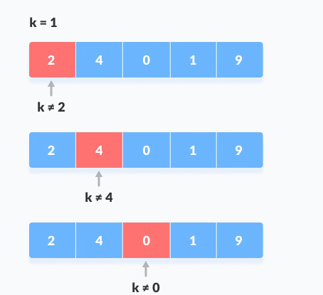
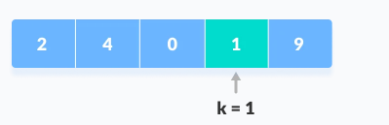
To search for an element 1 in the given array
Key element (k)=1
1. Start from first element, compare k with each element of array[x].
2. If x==k, return index.
3. else, return not found.

Slide 73
#include <stdio.h>
int main()
{
int array[5], search, i, n;
printf("Enter number of elements in array\n");
scanf("%d", &n);
printf("Enter %d integer(s)\n", n);
for (i = 0; i < n; i++)
scanf("%d", &array[i]);
printf("Enter a number to search\n");
scanf("%d", &search);
for (i = 0; i < n; i++)
{
if (array[i] == search) /* If required element is found */
{
printf("%d is present at location %d.\n", search, i+1);
break;
}
}
if (i == n)
printf("%d isn't present in the array.\n", search);
return 0;
}
Output:
Enter number of elements in array
5
Enter 5 integer(s)
12
4
5
19
20
Enter a number to search
5
5 is present at location 3.

Slide 74
Binary search
Binary Search is a searching algorithm for finding an element's position in a sorted array.
If the array isn't sorted, you must sort it using a sorting technique.
Binary search is faster than the linear search. Its time complexity is O(log(n)), while that of the linear search is O(n).
Binary Search Algorithm can be implemented in two ways:
Iterative Method
Recursive Method
The recursive method follows the divide and conquer approach.

Slide 75

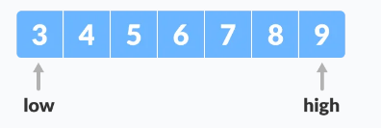
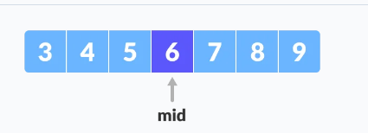
Let us consider a sorted array:
Let element to be searched is 4. (x=4)
0 1 2 3 4 5 6
1.Set two pointers at beginning and at end of array.
2.Find middle element (mid) of array using arr[(low+high)/2] //use index
i.e arr[(0+6)/2]
arr[3]=6

Slide 76
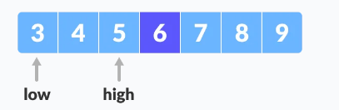
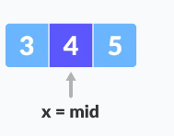
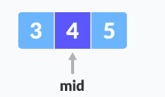
3.If x == mid, then return mid. Else, compare the element to be searched with m.
4.If x>mid, compare x with middle element of the elements on right side of mid using low = mid +1. (use index)
5. Else, compare x with the middle element of the elements on left side of mid using high=mid-1. (use index)
Mid index is 3.
High=3-1=2nd index (i.e 5)
6.Repeat steps 2 to 5 until low meets high.
7.x = 4 is found.

Slide 77
#include <stdio.h>
int main()
{
int i, first, last, middle, n, search, array[5];
printf("Enter number of elements\n");
scanf("%d", &n);
printf("Enter %d integers\n", n);
for (i = 0; i < n; i++)
scanf("%d", &array[i]);
printf("Enter value to find\n");
scanf("%d", &search);
first = 0;
last = n - 1;
middle = (first+last)/2;
while (first <= last) {
if (search>array[middle])
first = middle + 1;
else if (array[middle] == search) {
printf("%d found at location %d.\n", search, middle+1);
break;
}
else
last = middle - 1;
middle = (first + last)/2;
}
if (first > last)
printf("Not found! %d isn't present in the list.\n", search);
return 0;
}
Output:
Enter number of elements
5
Enter 5 integers
1
2
3
4
5
Enter value to find
3
3 found at location 3.

